Slide 1
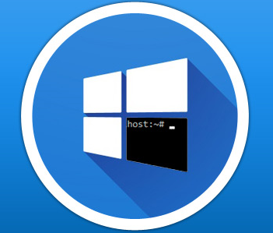
Bash on Ubuntu on Windows
Paul DeCarlo
Sr. Technology Evangelist
@pjdecarlo

Slide 2
Session objectives and takeaways
Session objective(s):
How to obtain the latest edition of Windows Subsystem for Linux that will be included in the upcoming Windows Anniversary update.
Understanding what Bash on Ubuntu for Windows is and the extent/ limitations of it's current features and functionality.
How the Bash on Ubuntu on Windows environment can assist in developer workflow and what this means to existing developers who rely on these tools on other platforms.
Notes:
How to obtain the latest edition of Windows Subsystem for Linux that will be included in the upcoming Windows Anniversary update.
Anniversary update currently slated for August 2, althou Windows Susbsystem for Linux already being included in recent Windows 10 Insider Preview
Understanding what Bash on Ubuntu for Windows is and the extent/ limitations of it's current features and functionality.
While this feature is currently a preview of what is to come, you will be surprised to see that many native Linux tools and programs work out the box. These range from ability to run popular text based command line tools like awk, sed, and grep to support for graphical applications
How the Bash on Ubuntu on Windows environment can assist in developer workflow and what this means to existing developers who rely on these tools on other platforms.
We will specifically show how today, you can begin integrating Bash on Ubuntu on Windows into your developer workflow in the cross-platform Visual Studio Code IDE to do things that were difficult beforehand. Specifically, we will look at building a static blog using the ruby-based Jekyll framework to deploy a site instance in azure. All without leaving the IDE and it’s integrated terminal

Slide 3
Agenda
Windows Subsystem for Linux:
Architectural overview of WSL
Obtaining and activating WSL on Windows 10
Bash on Ubuntu on Windows:
Introduction to Bash
Support for X11 + GTK graphical applications
Overview of current features and limitations
Using Bash in your developer workflow:
Networking tools – curl, whois, dig
Visual Studio Code Integration
Jekyll static site/blog generator on Ubuntu on Windows
Notes:
Here is a quick overview of the session agenda. We will begin by discuss Windows Subsytem for Linux with a high lever overview, next we will move into a demonstration of the features and functionatity present in Bash on Ubuntu on Windowsand conclude with a demonstration on how these tools can leverage new developer worlflows on Windows 10

Slide 4


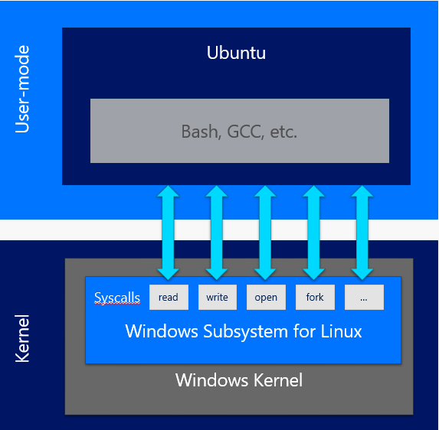



Windows Subsystem for Linux
Notes:
So what exactly is the Windows Susbsystem for Linux? Where did it come from, what can it do, and how can I get it?

Slide 5
Origins of WSL
Subsystems supported by design in NT
Posix, OS/2, and Win32 Subsystems
Subsystem for Unix-based Applications (SUA)
Implemented POSIX user mode APIs with NT constructs
Encouraged porting of *nix applications
Required recompilation
Drawbridge Project
Introduced concept of Pico process and Pico drivers
Notes:
Since its inception, Microsoft Windows NT was designed to allow environment subsystems like Win32 to present a programmatic interface to applications without being tied to implementation details inside the kernel. This allowed the NT kernel to support POSIX, OS/2 and Win32 subsystems at its initial release.
Early subsystems were implemented as user mode modules that issued appropriate NT system calls based on the API they presented to applications for that subsystem
When a user mode application got launched the loader invoked the right subsystem to satisfy the application dependencies based on the executable header.
The primary role of SUA was to encourage applications to get ported to Windows without significant rewrites. This was achieved by implementing the POSIX user mode APIs using NT constructs. While successful, this model relied on the need for programs to be recompiled in addition to ongoing feature porting which could become a maintenance burden.
Established in September of 2011. Drawbridge is a research prototype of a new form of virtualization for application sandboxing. This introdued the picoprocess , a lightweight, secure isolation container that is built from an OS process address space, but with all traditional OS services removed

Slide 6
Windows Subsystem for Linux (WSL)
Run native Linux ELF64 binaries on Windows
No VM’s – REAL Linux tools. On Windows. In Windows. Together!
Accomplished via:
User mode session manager (LX Session Manager)
Pico provider drivers (lxss.sys, lxcore.sys)
Pico process for hosting /bin/bash
Notes:
Over time these initial subsystems were retired. However, since the Windows NT Kernel was architected to allow new subsystem environments, we were able to use the initial investments made in this area and broaden them to develop the Windows Subsystem for Linux.
WSL is a collection of components that enables native Linux ELF64 binaries to run on Windows. It contains both user mode and kernel mode components. It is primarily comprised of:
User mode session manager service that handles the Linux instance life cycle
Pico provider drivers (lxss.sys, lxcore.sys) that emulate a Linux kernel by translating Linux syscalls
Pico processes that host the unmodified user mode Linux (e.g. /bin/bash)
On the next slide we will see how WSL handles Linux syscalls by coordinating between the NT kernel and a pico driver which contains a clean room implementation of the Linux syscall interface. As of writing, lxss.sys has ~235 of the Linux syscalls implemented with varying level of support. This support will continue to improve over time especially with the great feedback we get from the community.

Slide 7
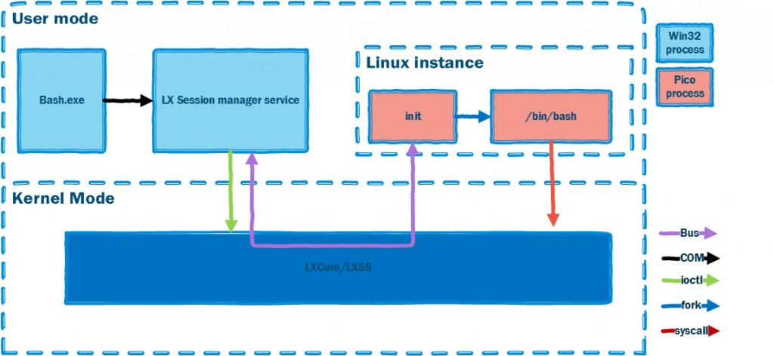
Windows Subsystem for Linux
Runs on the NT Kernel:
Notes:
The first time an NT process requests launching a Linux binary a Linux instance is created. Native unmodified Linux binaries (or executable ELF files) are loaded into a Pico process’s address space and executed atop a Linux-compatible layer of syscalls. A syscall is a service provided by the kernel that can be called from user mode. Both the Linux kernel and Windows NT kernel expose several hundred syscalls to user mode, but they have different semantics and are generally not directly compatible.
These Pico processes and drivers provide the foundation for the Windows Subsystem for Linux. While WSL includes kernel mode drivers (lxss.sys and lxcore.sys) that are responsible for handling Linux system call requests in coordination with the Windows NT kernel. The drivers do not contain code from the Linux kernel but are instead a clean room implementation of Linux-compatible kernel interfaces. On native Linux, when a syscall is made from a user mode executable it is handled by the Linux kernel. On WSL, when a syscall is made from the same executable the Windows NT kernel forwards the request to lxcore.sys. Where possible, lxcore.sys translates the Linux syscall to the equivalent Windows NT call which in turn does the heavy lifting. Where there is no reasonable mapping the Windows kernel mode driver must service the request directly.

Slide 8
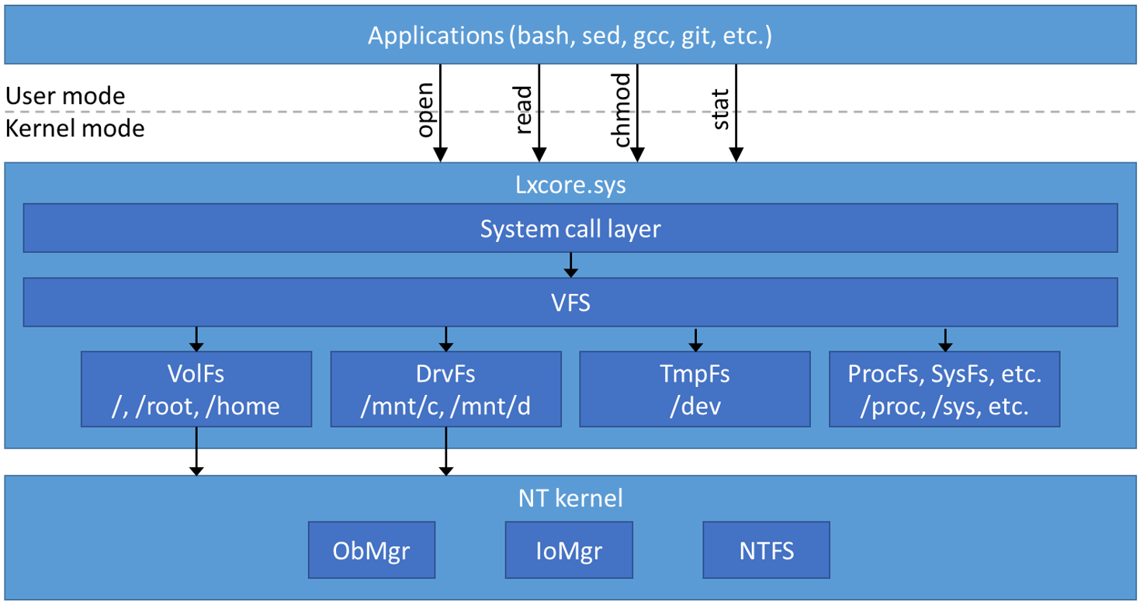
WSL File System
File system requirements
Provide an environment that supports the full fidelity of Linux file systems
Allow interoperability with drives and files in Windows
Accomplished via:
VolFs
DriveFs
Notes:
File system support in WSL was designed to meet two goals.
Provide an environment that supports the full fidelity of Linux file systems
Allow interoperability with drives and files in Windows
The Windows Subsystem for Linux provides virtual file system support similar to the real Linux kernel. Two file systems are used to provide access to files on the users system: VolFs and DriveFs.
VolFs is a file system that provides full support for Linux file system features, including:
•Linux permissions that can be modified through operations such as chmod and chroot
•Symbolic links to other files
•File names with characters that are not normally legal in Windows file names
•Case sensitivity
Directories containing the Linux system, application files (/etc, /bin, /usr, etc.), and users Linux home folder, all use VolFs.
Interoperability between Windows applications and files in VolFs is not supported.
DriveFs is the file system used for interoperability with Windows. It requires all files names to be legal Windows file names, uses Windows security, and does not support all the features of Linux file systems. Files are case sensitive and users cannot create files whose names differ only by case.
All fixed Windows volumes are mounted under /mnt/c, /mnt/d, etc., using DriveFs. This is where users can access all Windows files. This allows users to edit files with their favorite Windows editors such as Visual Studio Code, and manipulate them with open source tools in Bash using WSL at the same time.

Slide 9
The Result
Run native Linux binaries on Windows
No VM’s – REAL Linux tools. On Windows. In Windows. Together!
Unix/Linux tools now run on Windows
Bash, ssh, grep, sed, awk, etc.
Support for platforms used by OSS projects
Ruby, Python, Java, node, etc
Notes:
By integrating the Linux environment into Windows through WSL, you can now run native Linux binaries on Windows! This opens up the opportunity to run popular *nix based applications like bash, ssh, grep, sed, awk etc without need for recompilation or a Virtual Machine to host a compatible operating system. Furthermore, developers can leverage this environment to create and execute code leveraging a variety of programming languages supported by *nix environments.

Slide 10
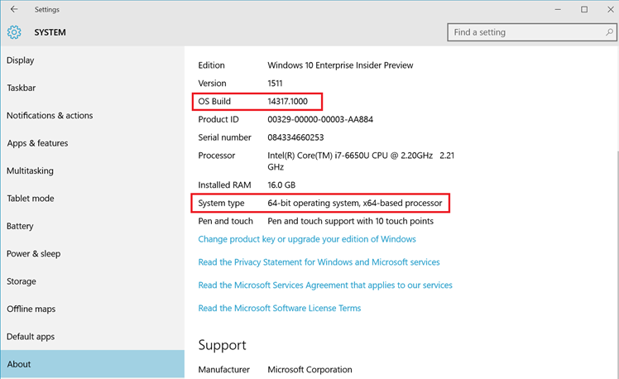
Activating Windows Subsystem for Linux
Prerequisites:
Must be running on an AMD/Intel x64 compatible CPU & OS
Must be running a 64-bit version of Windows 10 Anniversary Update version 16xx / build 14316 or later
Notes:
Activating Windows Subsystem for Linux
First things first, ensure you have compatible hardware. WSL requires an AMD/Intel x64 compatible CPU & OS
Next ensure you are running a 64-bit version of Windows 10 Anniversary Update version 16xx / build 14316 or later

Slide 11
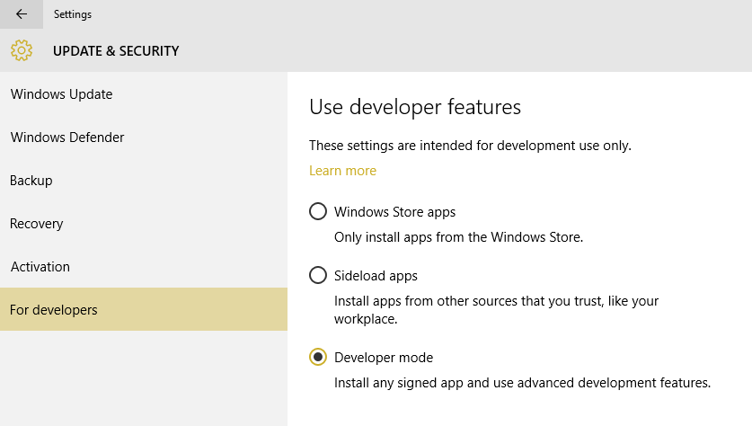
Activating Windows Subsystem for Linux
Turn on Developer Mode:
Settings | Update & Security | For Developers | Check the Developer Mode radio button:
Notes:
Next, head to settings and turn on developer mode

Slide 12
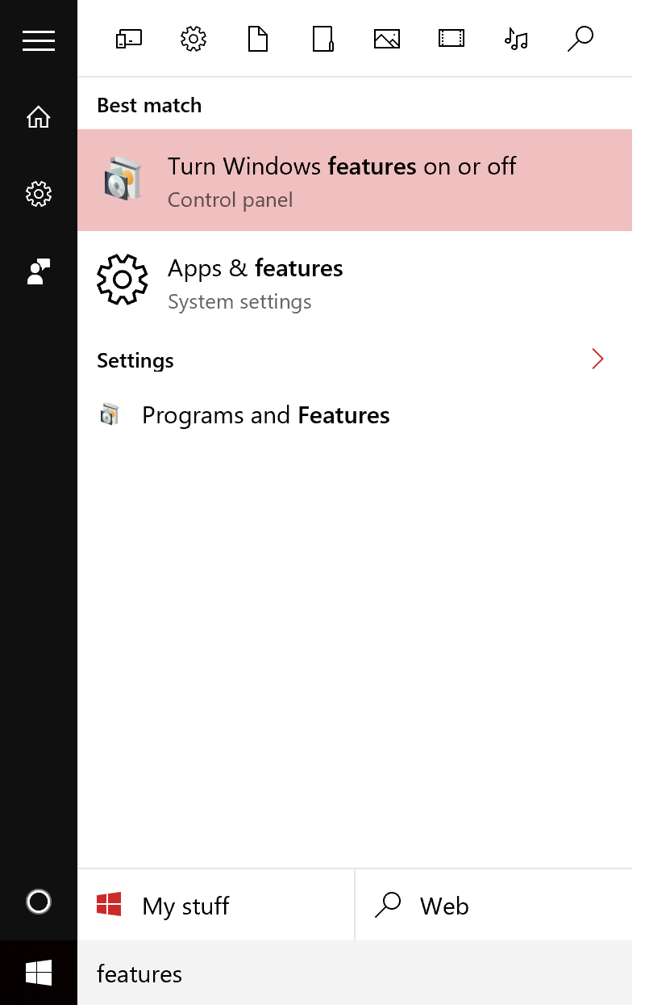
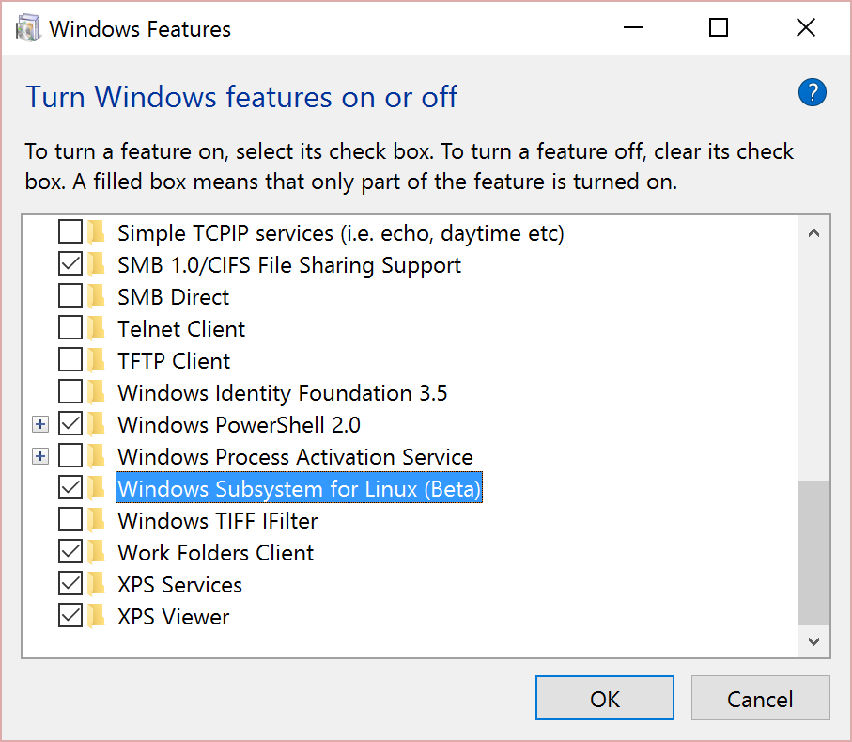
Activating Windows Subsystem for Linux
From the start menu, open “Turn Windows Features on or off”:
Notes:
Now head to Windows feaature and check the box next to Windows Subsystem for Linux (Beta) and reboot

Slide 13
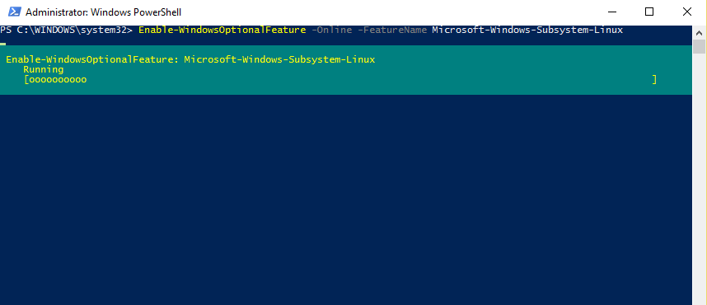
Activating Windows Subsystem for Linux
Alternately:
Open a PowerShell prompt as administrator and run:
Enable-WindowsOptionalFeature -Online -FeatureName Microsoft-Windows-Subsystem-Linux
Notes:
Alternately:
Open a PowerShell prompt as administrator and run: Enable-WindowsOptionalFeature -Online -FeatureName Microsoft-Windows-Subsystem-Linux

Slide 14
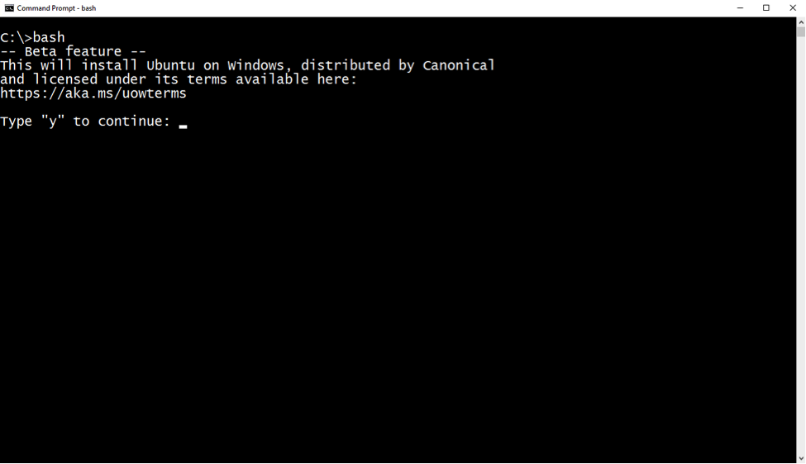
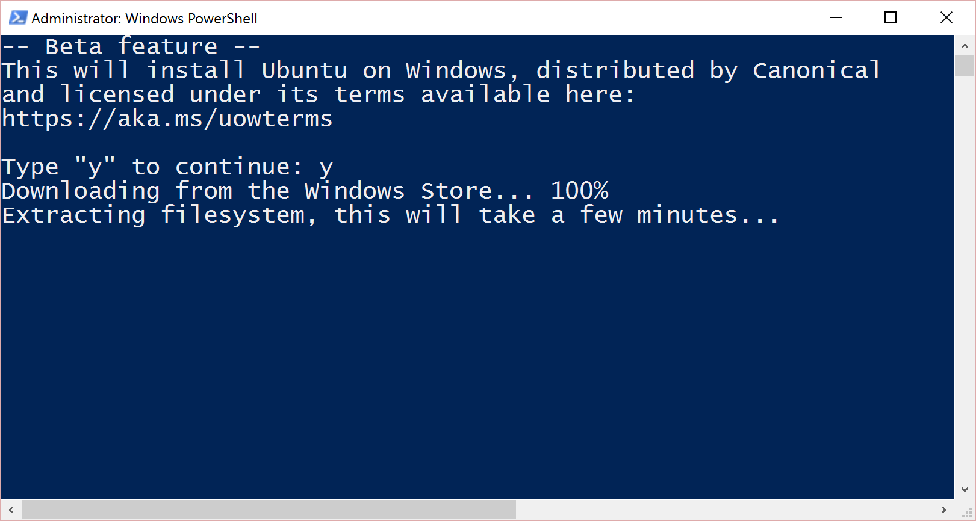
Installing Bash on Ubuntu on Windows
From CMD or PowerShell prompt and run “Bash” Then follow the simple prompts to accept Canonical’s license
Notes:
Upon reboot, hit the windows key and type “bash” to bring up the bash on Ubuntu on Windows installer. And there you have it!

Slide 15
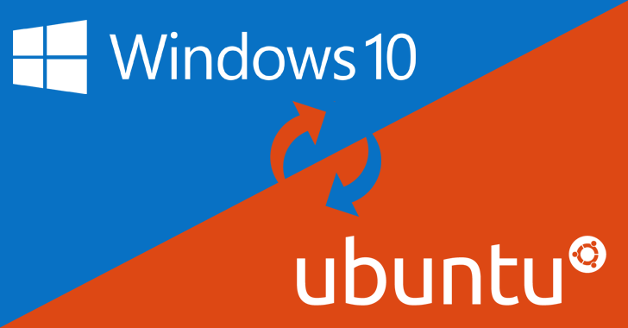
Bash on Ubuntu on Windows
Notes:
Without further ado, Let’s introduce Bash on Ubuntu on Windows – created in partnership with Canonical - maintainers of the popular debian based Ubuntu Linux distro on running on our new distro-agnostic, Linux compatible subsystem

Slide 16
Demo
What you are about to see …
… Is a preview
… Of Ubuntu usermode tools
… Running on the new Windows Subsystem for Linux (WSL)
… Available now in Windows 10 Anniversary Edition
[No VM’s are required to reproduce this demo!]

Slide 17
Demo example
Let’s take a look at the filesystem: ls /
What CPU are we using? less /proc/cpuinfo
Let’s run something fun: fortune (notice prompt to install)
Oh! Ok, let’s install fortune: sudo apt-get install fortune
Now lets try again: fortune (view output)
Let’s make this even more fun: sudo apt-get install cowsay
Let’s see what a bovine philosopher might say: fortune | cowsay
Shall we check the weather in Hobbiton? clear; curl -4 wttr.in/middle-earth
Dd
d

Slide 18
C++ Demo Example
Any dev’s in the room?
Note: run this beforehand – can take a while!
sudo-apt-get install build-essential –y
cd ~/
mkdir demo
cd demo
vim hello.cpp
#include <iostream>
int main(void)
{
std::cout << std::endl << "Hello World!\n" << std::endl;
return 0;
}
:wq
g++ hello.cpp –o hello
And run it: ./hello

Slide 19
Ruby Demo Example
Any Ruby dev’s in the room?
Note: run this beforehand – takes a short while!
sudo-apt-get install ruby –y
cd ~/
mkdir demo
cd demo
vim hello.rb
puts ‘Hello World!’
:wq
ruby hello.rb

Slide 20
Python Demo Example
Any Python dev’s in the room?
Note: run this beforehand – takes a short while!
Sudo apt-get install python –y
cd ~/
mkdir demo
cd demo
vim hello.py
print(‘Hello World!’)
:wq
python hello.py

Slide 21
.NET Core
The open source, cross-platform fork of the .NET Framework
Note: run this beforehand – takes a short while!
sudo sh -c 'echo "deb [arch=amd64] https://apt-mo.trafficmanager.net/repos/dotnet/ trusty main" > /etc/apt/sources.list.d/dotnetdev.list'
sudo apt-key adv --keyserver apt-mo.trafficmanager.net --recv-keys 417A0893
sudo apt-get update
sudo apt-get install dotnet-dev-1.0.0-preview2-003121e
cd ~/
mkdir demo
cd demo
dotnet new
dotnet restore
dotnet run

Slide 22
What we just saw
User-mode
Ubuntu
Native Linux tools
Bash, apt-get, fortune & cowsay
GNU C++, Ruby, .NET Core
On Windows Subsystem for Linux
A new feature of the Windows kernel
Exposes a Linux-compatible syscall layer
Bash, GC++, etc.
Windows Kernel
Kernel
Windows Subsystem for Linux
Syscalls
read
write
open
fork
…

Slide 23
What works … and what doesn’t?
This is a preview of a brand new technology
THERE WILL BE GAPS!
Many popular Linux tools Work Well In Testing™
Bash, apt-get, Ruby, git, Python, GC++, Quake
Things to avoid right now
NPM has some issues
Go, Rust & CoreCLR have issues (working on fixes)
We’re working hard to close gaps
MANY scenarios are untested …
List maintained @ https://github.com/ethanhs/WSL-Programs

Slide 24
Using Bash in your Developer Workflow

Slide 25
Networking tools work out the box
DNS tools
curl
whois
nslookup
dig
Remote Client Support
ssh
telnet

Slide 26
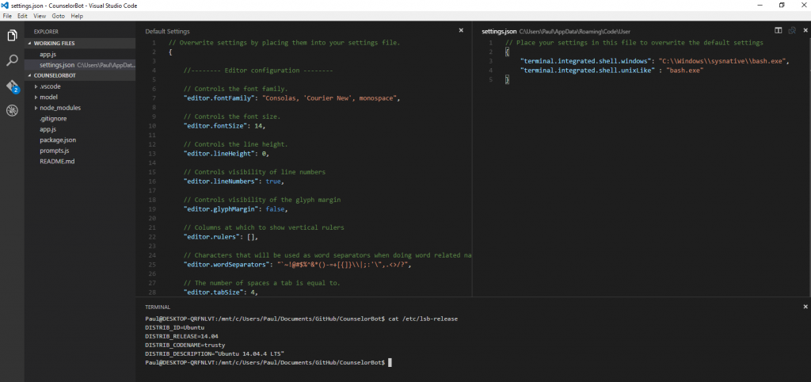
Integration with VS Code
Visual Studio 1.2.0 supports integrated terminal
File | Preferences | User Setting | add the following to settings.json:
“terminal.integrated.shell.windows”: “C:\\Windows\\sysnative\\bash.exe”

Slide 27

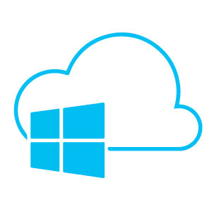
Demo
A ruby developer deploying a Jekyll generated blog to Azure from VS Code running on Windows 10
Steps @ aka.ms/jekylldemo

Slide 28
Call to Action
We need your help!
Kick the t[y|i]res!
Flighting in Windows 10 fast-ring builds 14316+
Arriving in Windows 10 Anniversary Update (Summer 2016)
Tell us …
What’s broken
What works!
What you’d like changed
Share your experiences
Blog, tweet, speak, show

Slide 29
Community
We’re building an array of community tools
UserVoice (Ideas & asks): https://aka.ms/winbashuv
GitHub Issues: https://aka.ms/winbashgithub
Blogs:
WSL: https://blogs.msdn.microsoft.com/wsl
Console & Command-line: https://blogs.msdn.Microsoft.com/commandline
Twitter
Follow @richturn_ms for LOTS of updates!

Slide 30
Q/A

